Slide 1

OLIST STORE ANALYSIS PROJECT
Prepared By : Group No.4
1. RITIN TARPADA
2. MADHUSHREE MURGOD
3. SWAPNARANI SANTI
4. UYYALA PRAVALLIKA
5. EKTA BIMAL KUMAR SINGH
6. KRISHNANUNNI K.A
7. POOJA.K

Slide 2
Contents:
1. Overview
2. List of KPI’s
3. Dashboard
4. Insights
5. Recommendations
6. Conclusion

Slide 3
Overview
The Olist Store Analysis project aims to analyze customer purchasing patterns and payment statistics on an Ecommerce platform.
The analysis is based on nine CSV files, which are cleaned and manipulated to extract valuable insights.

Slide 4
List of KPI’s
1. Weekday Vs Weekend (order_purchase_timestamp) Payment Statistics
The analysis of payment statistics based on weekday vs. weekend provides an understanding of the buying behavior of customers. and can also help Olist to improve their weekend sales and plan promotions accordingly.
2. Number of Orders with review score 5 and payment type as credit card.
This KPI analyzes the Number of Orders with review score 5 and payment type as credit card provides an understanding customer satisfaction levels and payment preferences. Olist can use this information to identify satisfied customers and encourage them to make repeat purchases.
3. Average number of days taken for order_delivered_customer_date for pet_shop
This KPI analyzes the average number of days taken for order_delivered_customer_date for pet_shop. It helps Olist in identifying areas where they can improve their delivery time and maintain customer satisfaction.
4. Average price and payment values from customers of sao paulo city
The analysis of Average price and payment values from customers of sao paulo city provides an understanding the spending patterns of customers in sao paulo city .it also helps Olist in identifying high value customers and creating targeted marketing campaigns.
5 Relationship between shipping days (order_delivered_customer_date - order_purchase_timestamp) Vs review scores.
The analysis of relationship between shipping days and review scores. It helps in understanding the impact of delivery time on customer satisfaction levels. Olist can use this information to optimize their logistics and improve their delivery time.

Slide 5
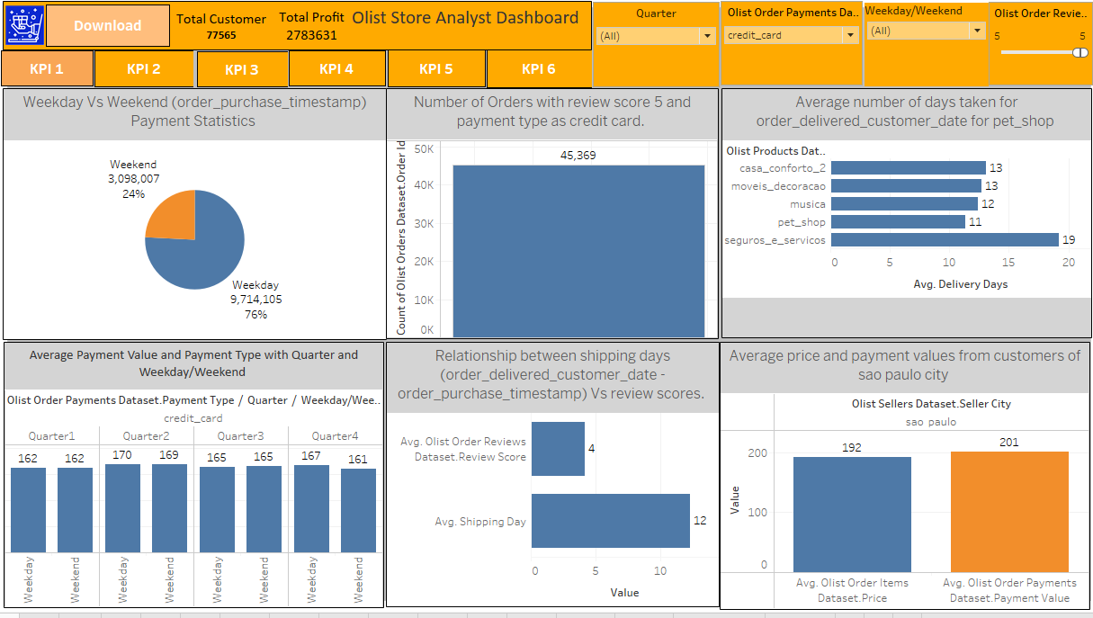
Tableau Dashboard :

Slide 6
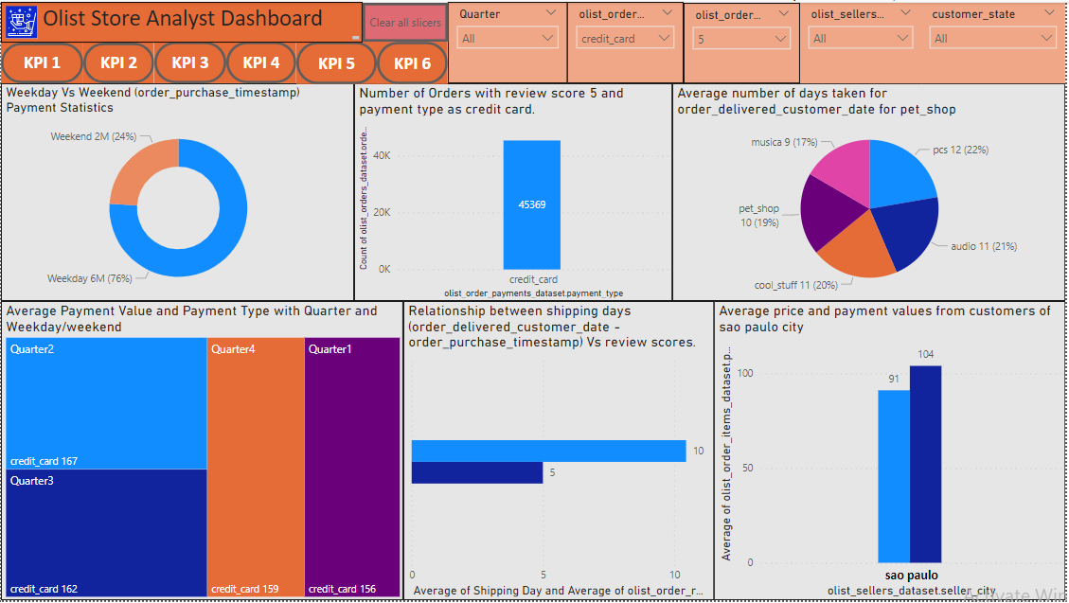
Power BI Dashboard :

Slide 7
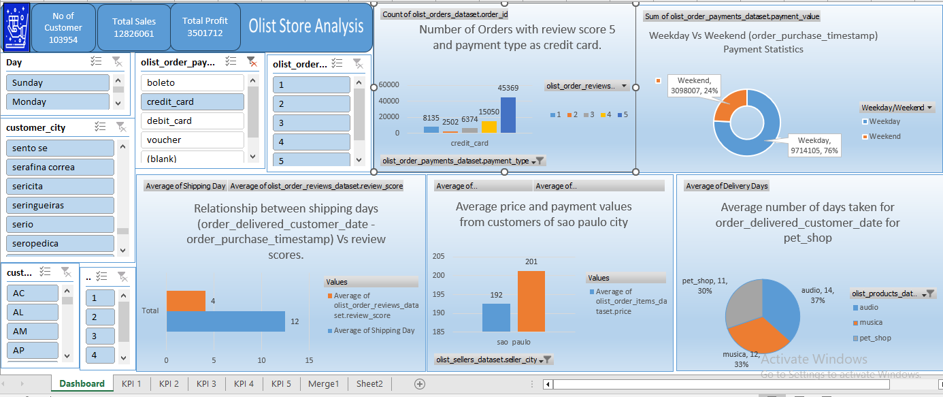
Excel Dashboard

Slide 8
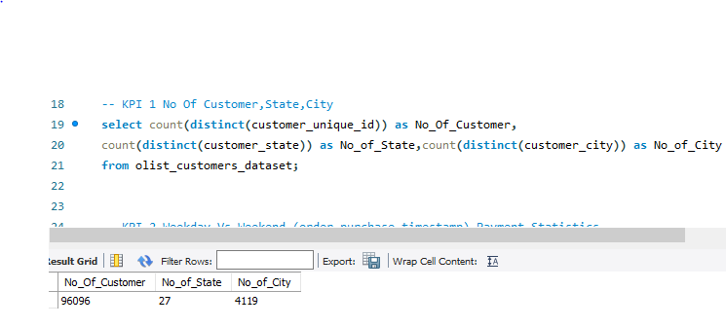
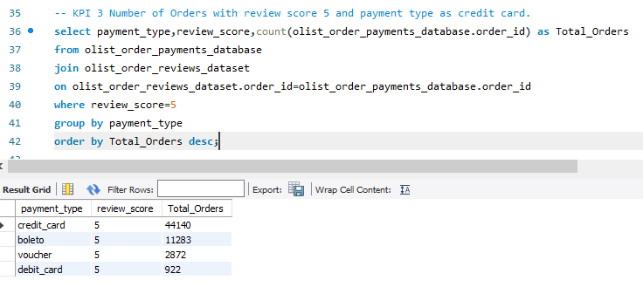
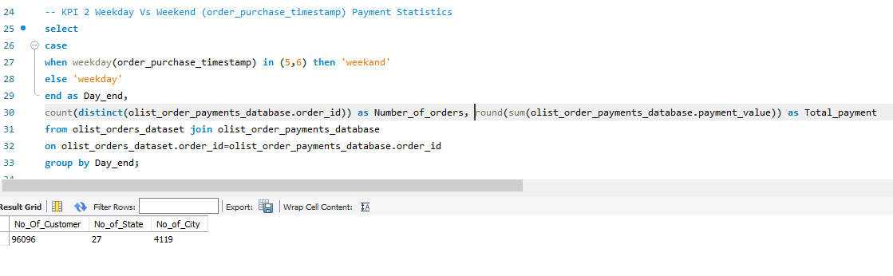
SQL Work

Slide 9
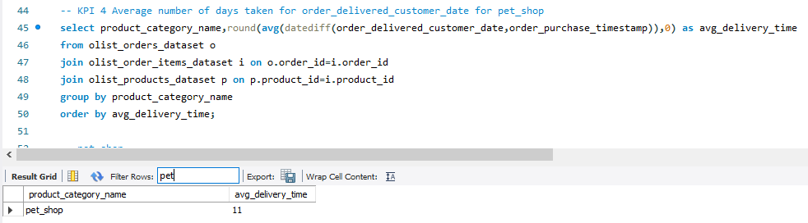
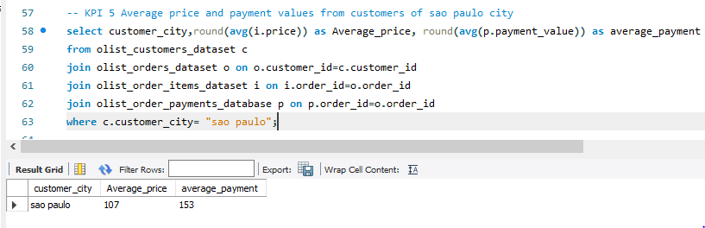
SQL Work

Slide 10
Insights
Insights from this analysis can help in making business decisions, such as focusing on products that customers are interested in, improving product and service quality
In addition, this analysis also provides an overview of customer consumption trends and patterns that can be used to direct further business strategies

Slide 11
Recommendations
Regularly monitor and analyze customer reviews to gain insights in product quality and identify areas for improvement.
This will provide a data-driven approach to enhance customer experience.
Dashboards can be used to identify patterns in customer reviews.

Slide 12
Conclusion
The Olist Store Analysis project provides valuable insights into customer behavior and payment statistics.
The analysis of these KPIs helps Olist in identifying areas of improvement and creating targeted marketing campaigns.
This project serves as a great example of how data analysis can help businesses make informed decisions..

Slide 13
Thank You

